Slide 1
Troubleshooting low community biomass in BU-Neutral
25 sims
Reset sim to pre-May 1 and ran with original data – looked OK for 10 sims, but problem showed up at 25 sims; problem existed before May 1

Slide 2
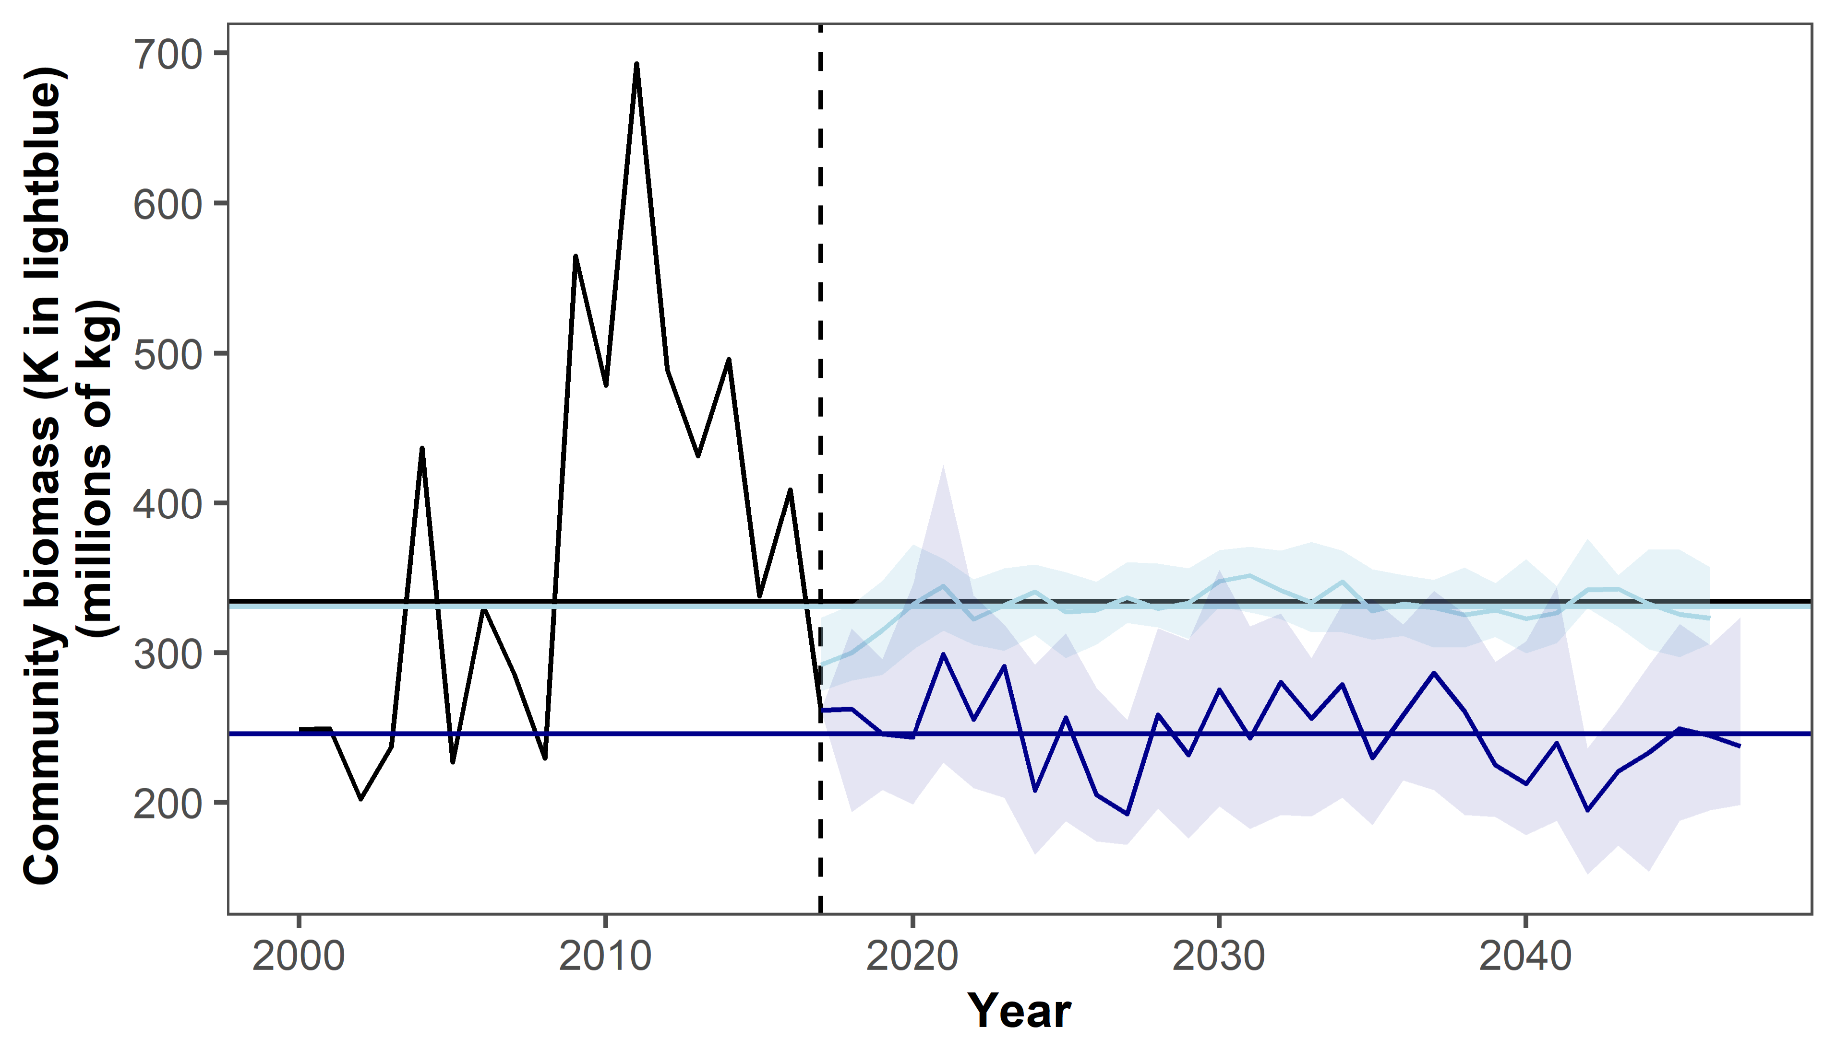
Notes:
Community biomass (darkblue) and K (lightblue). K looks really good, but biomass is too low.

Slide 3
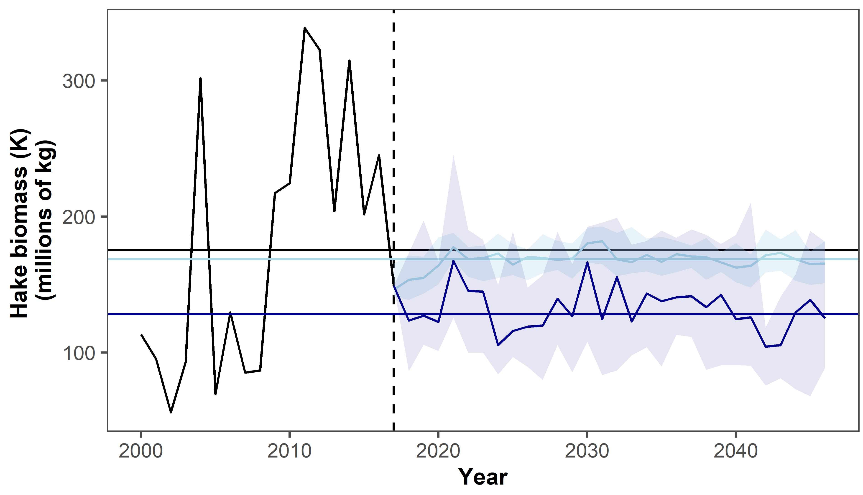
Notes:
Here’s silver hake – K is in right spot, but biomass never getting up to its K
Stock K is starting at last year’s biomass! Could this be the problem?

Slide 4
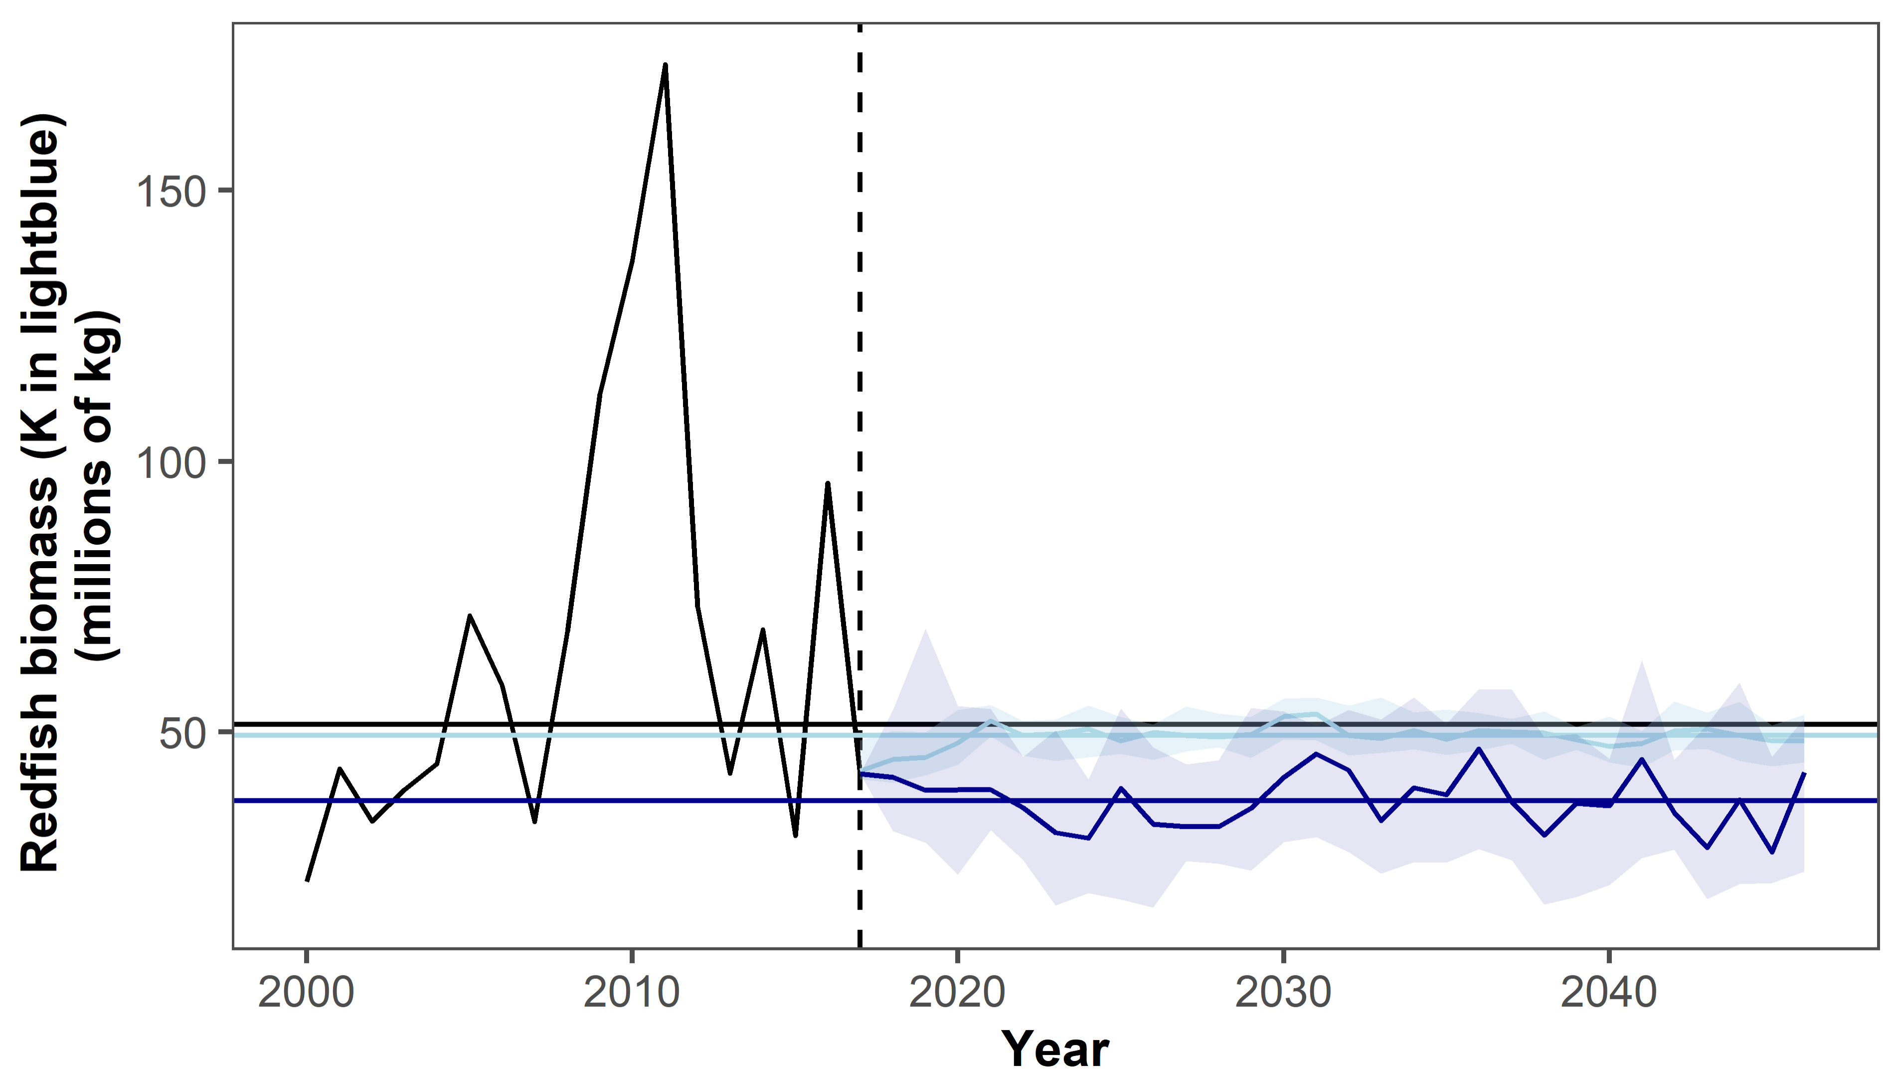
Notes:
Same pattern for redfish!

Slide 5
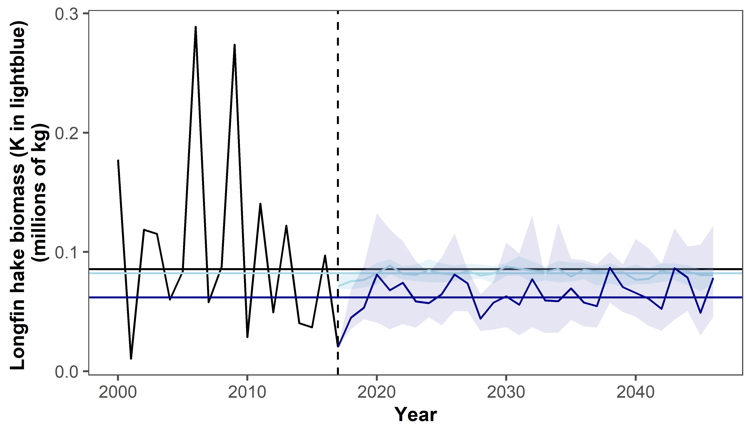
Notes:
K being same last last year not happening in longfin hake! This is more the pattern we’d expect (maybe because ts is spikier?). Stock is still too low

Slide 6
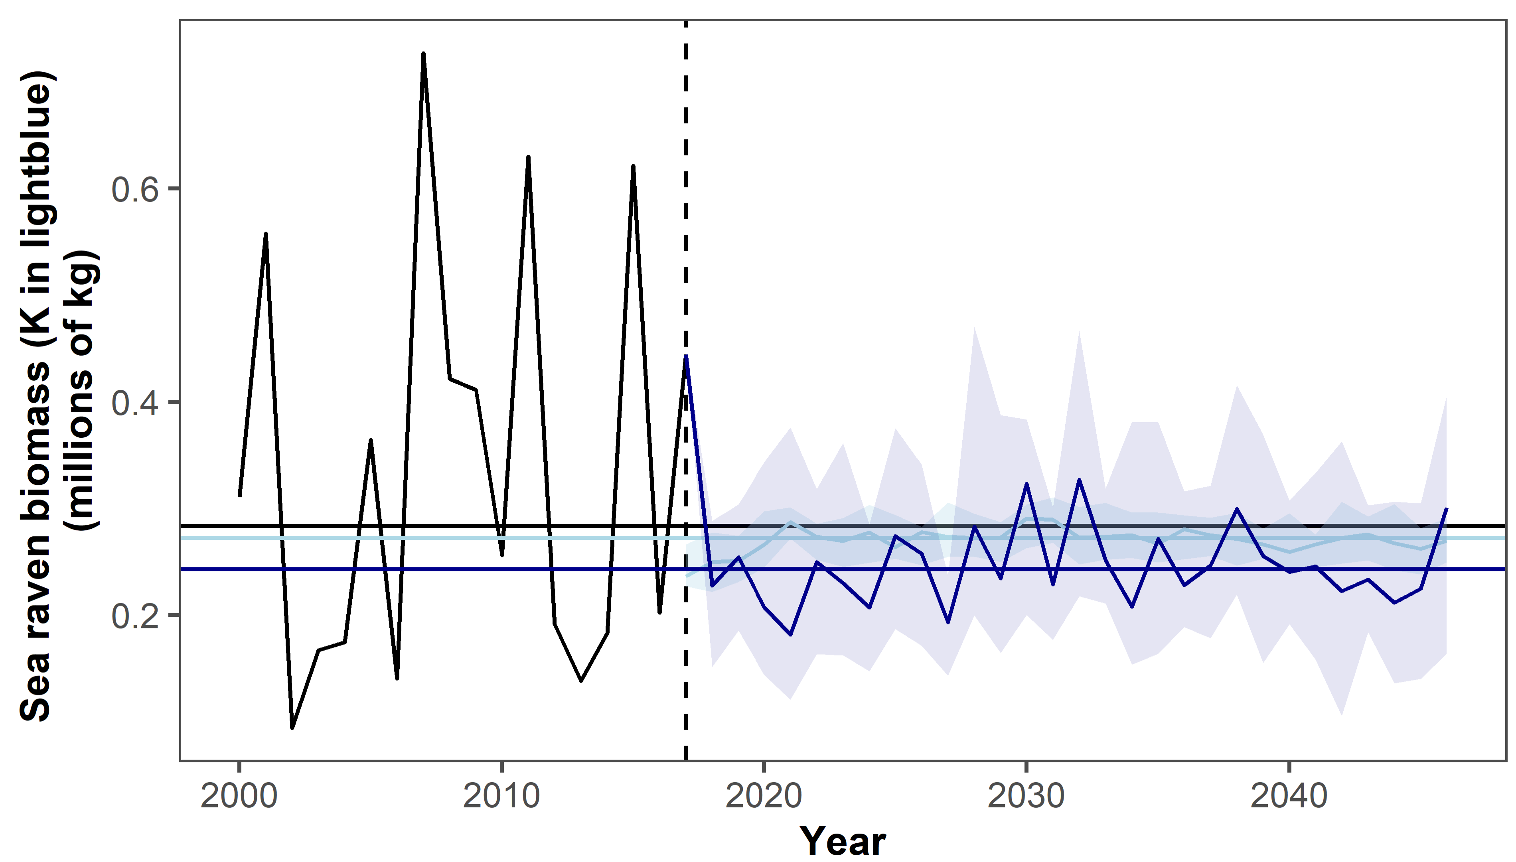

Slide 7
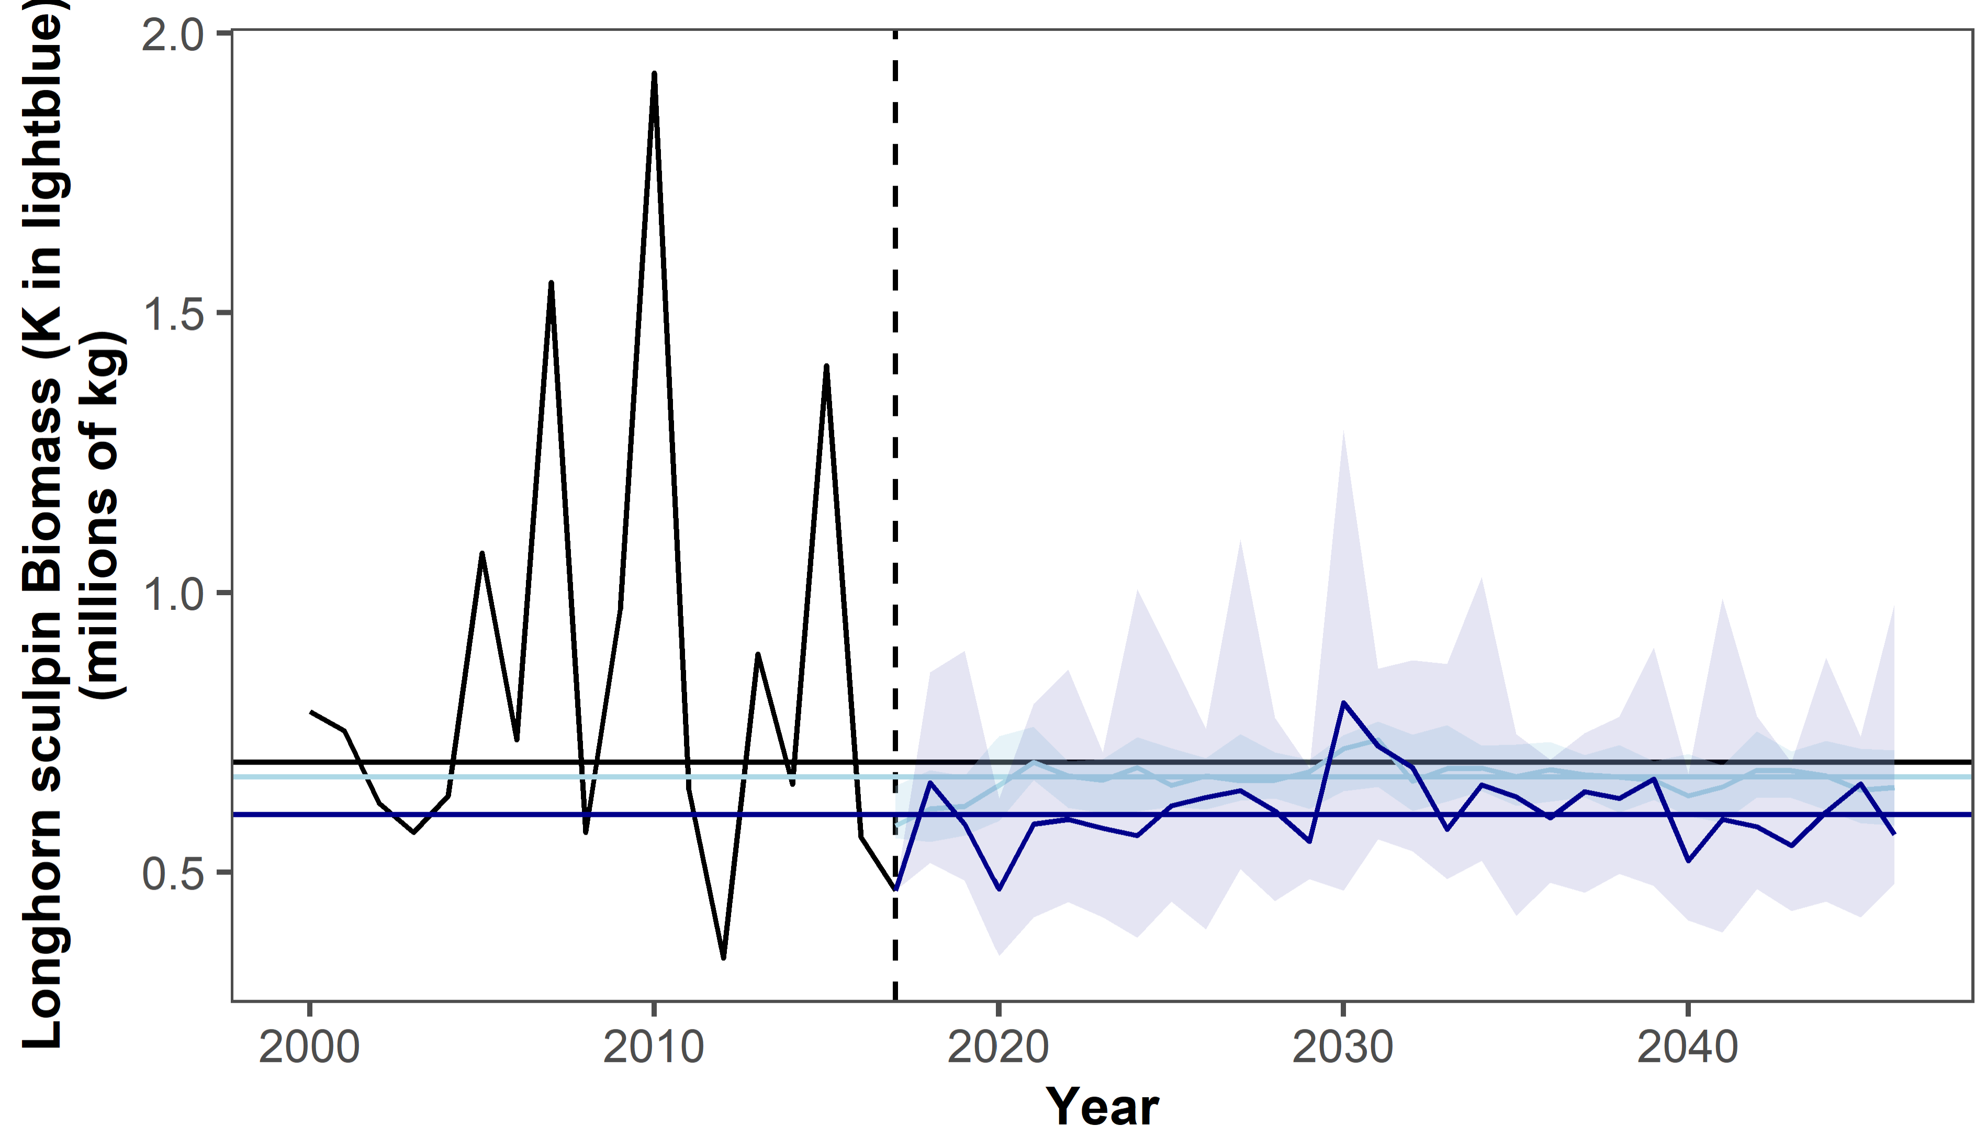

Slide 8
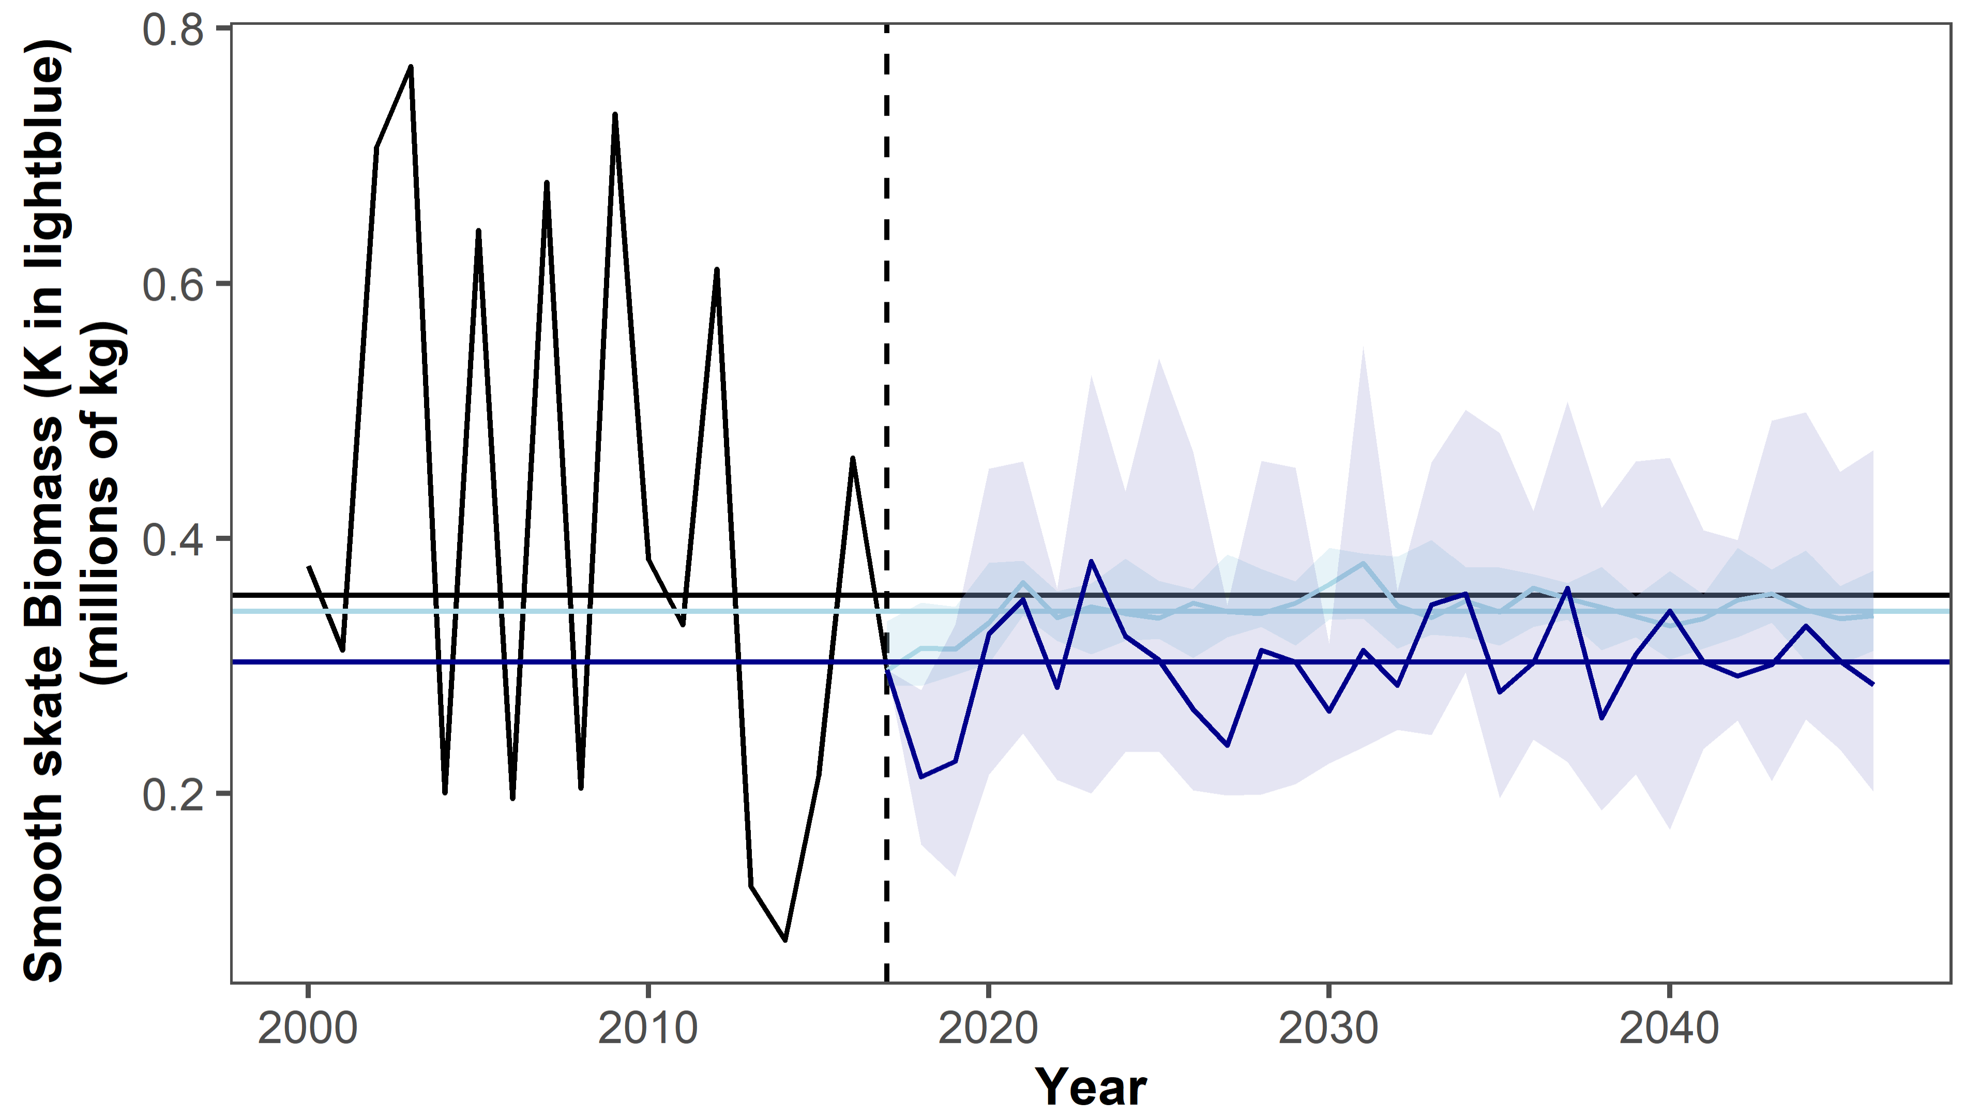
Notes:
Smooth skate does starting thing

Slide 9
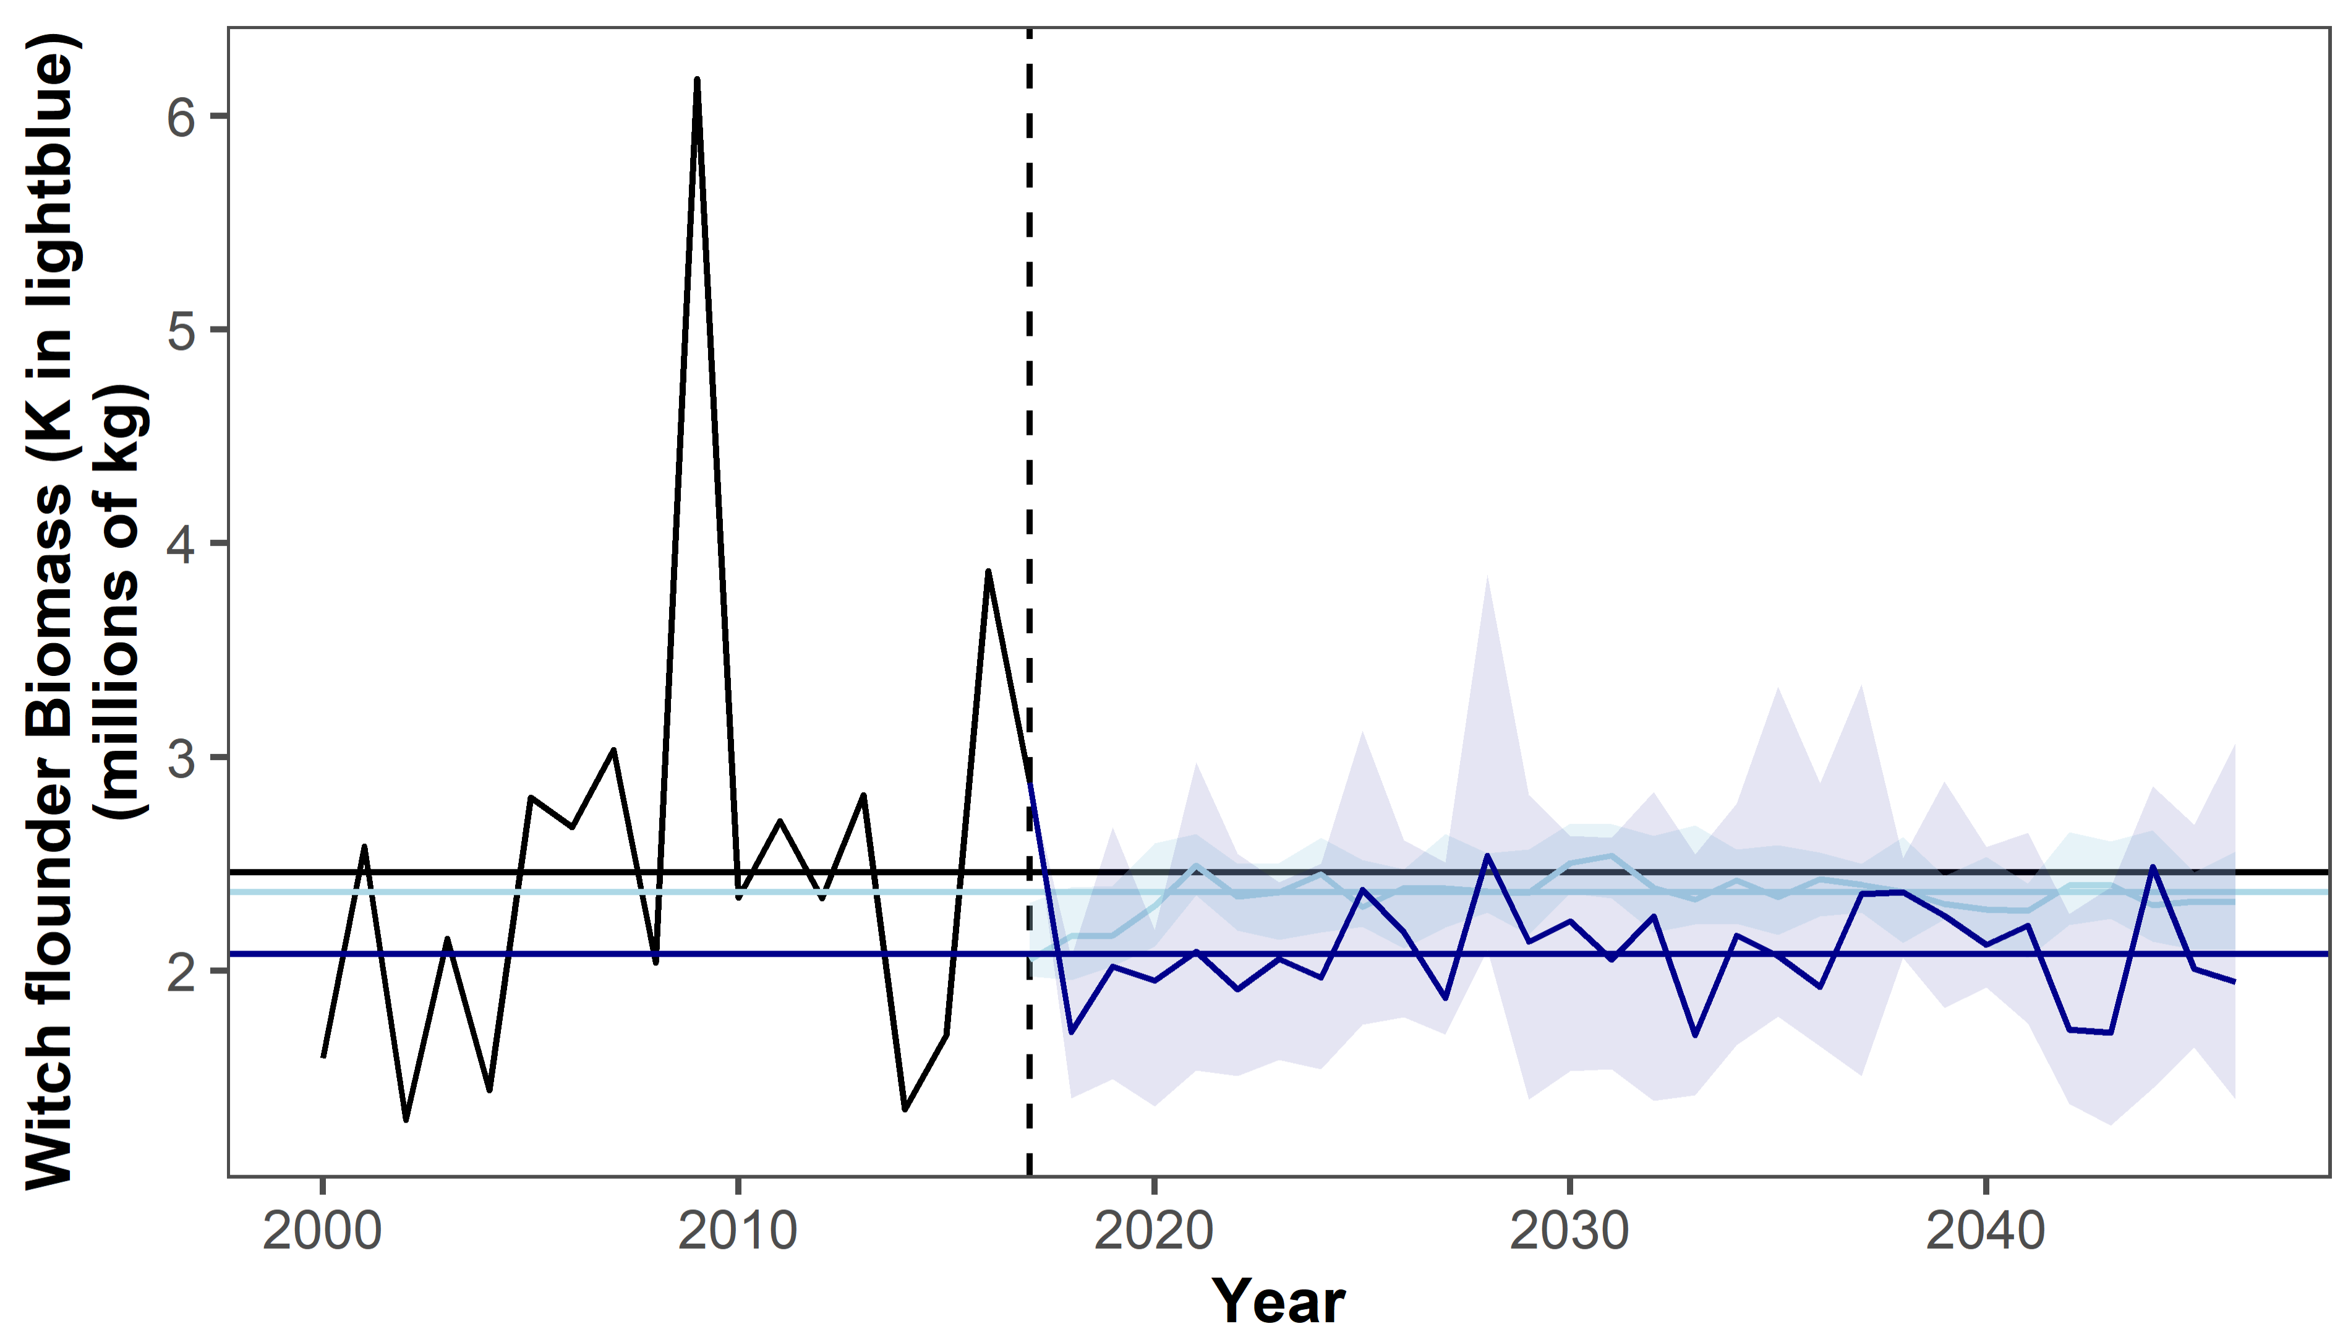

Slide 10
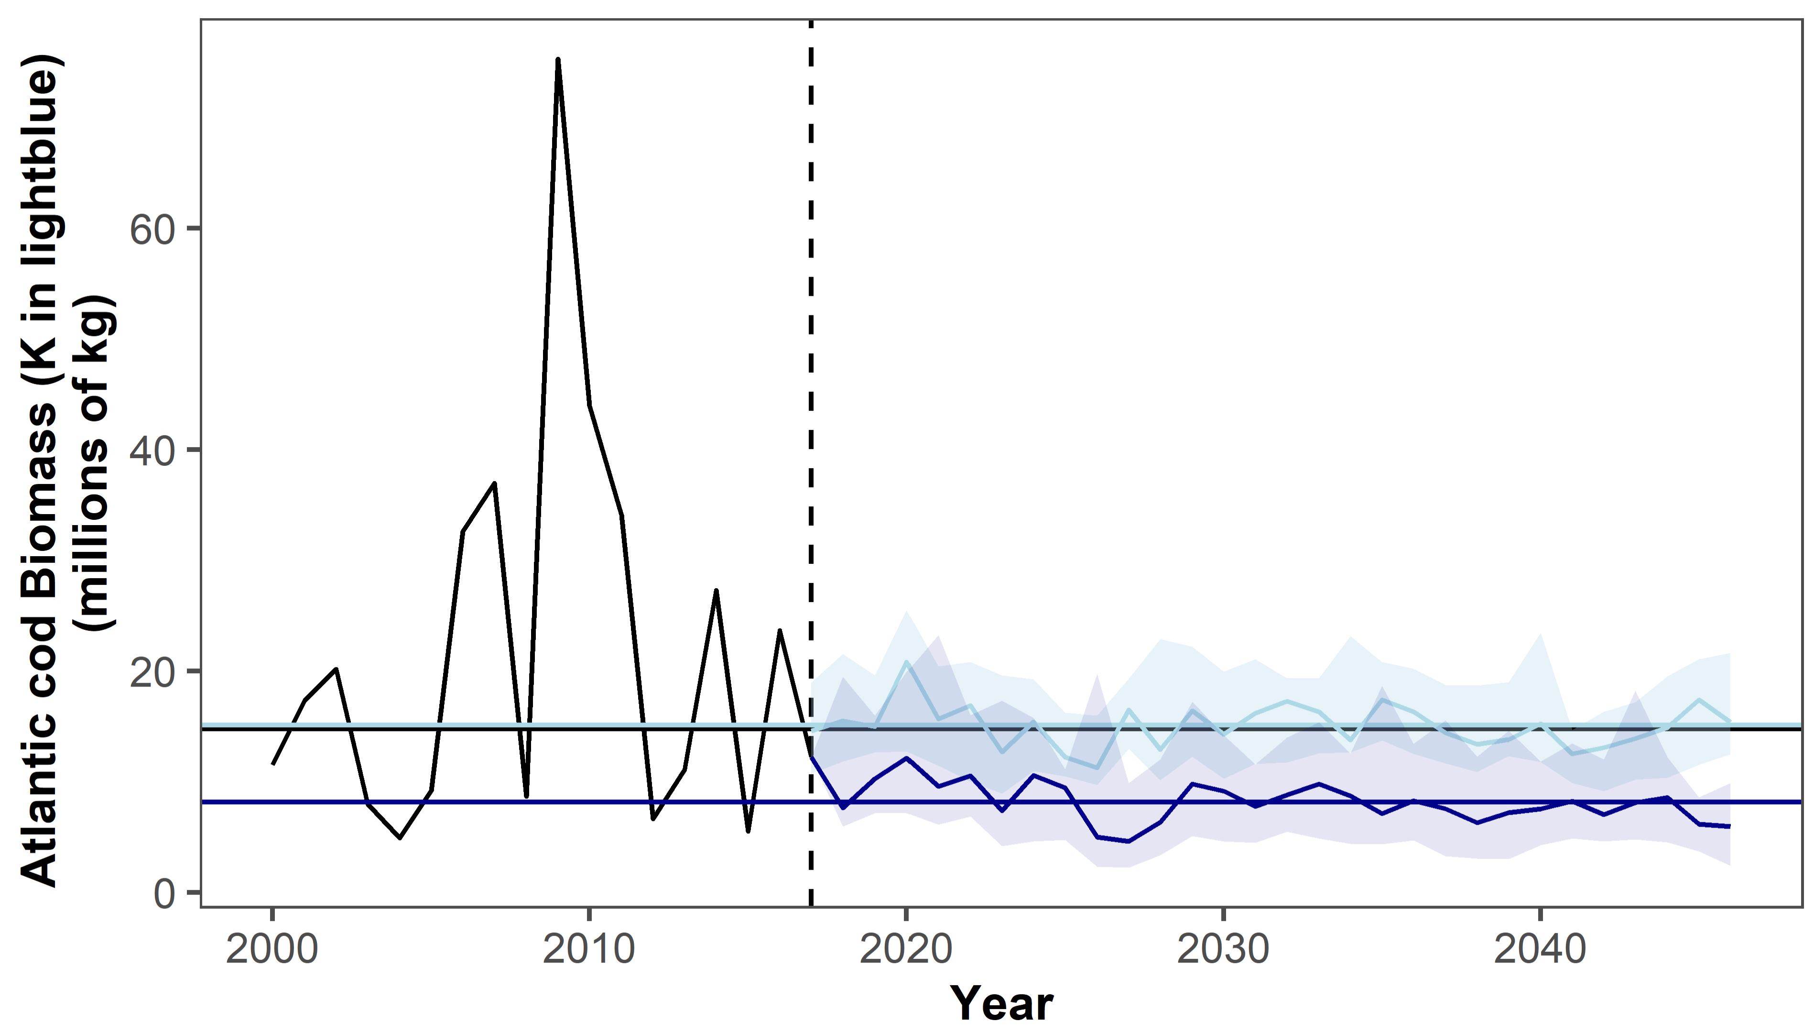
Notes:
Cod’s K is slightly above median, but biomass still isn’t getting up

Slide 11
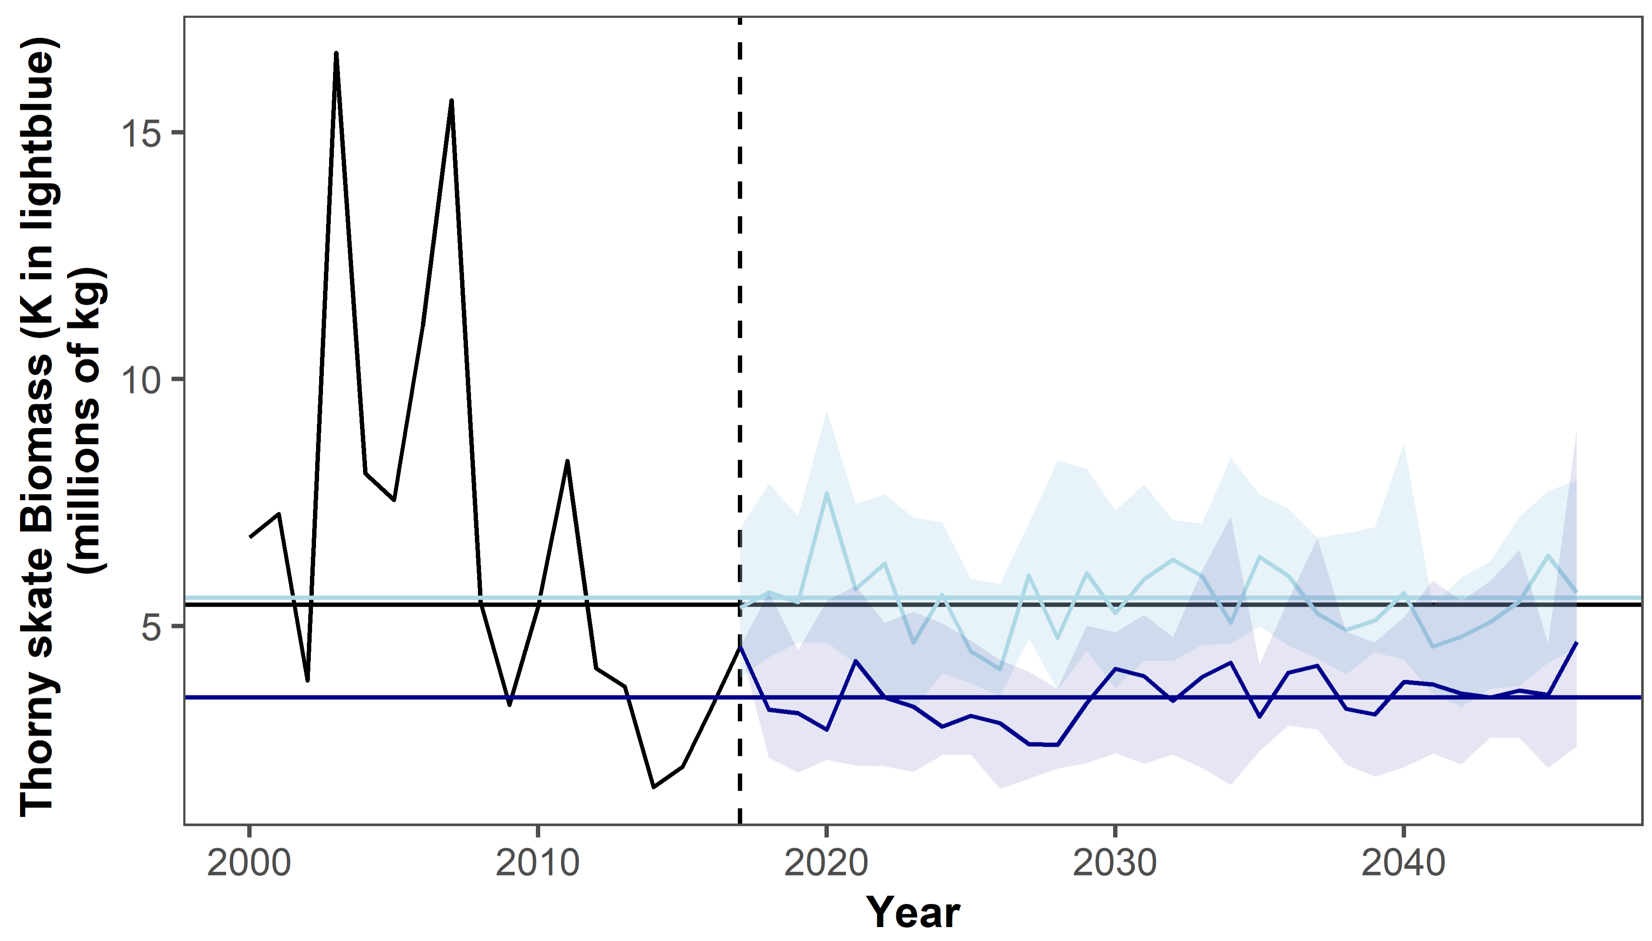
Notes:
Same with thorny

Slide 12
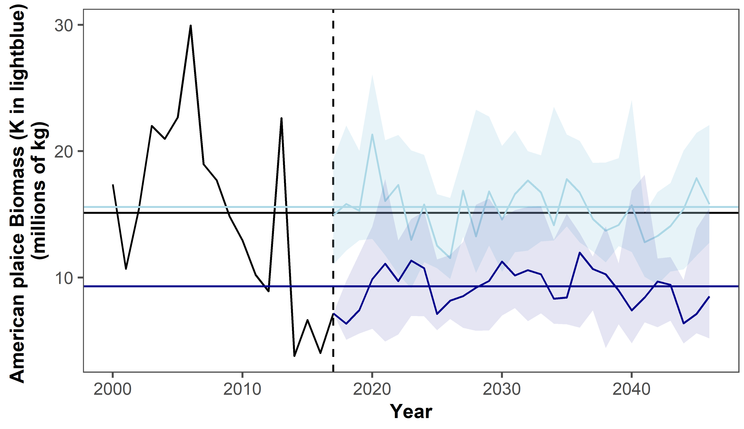
Notes:
Same with thorny

Slide 13
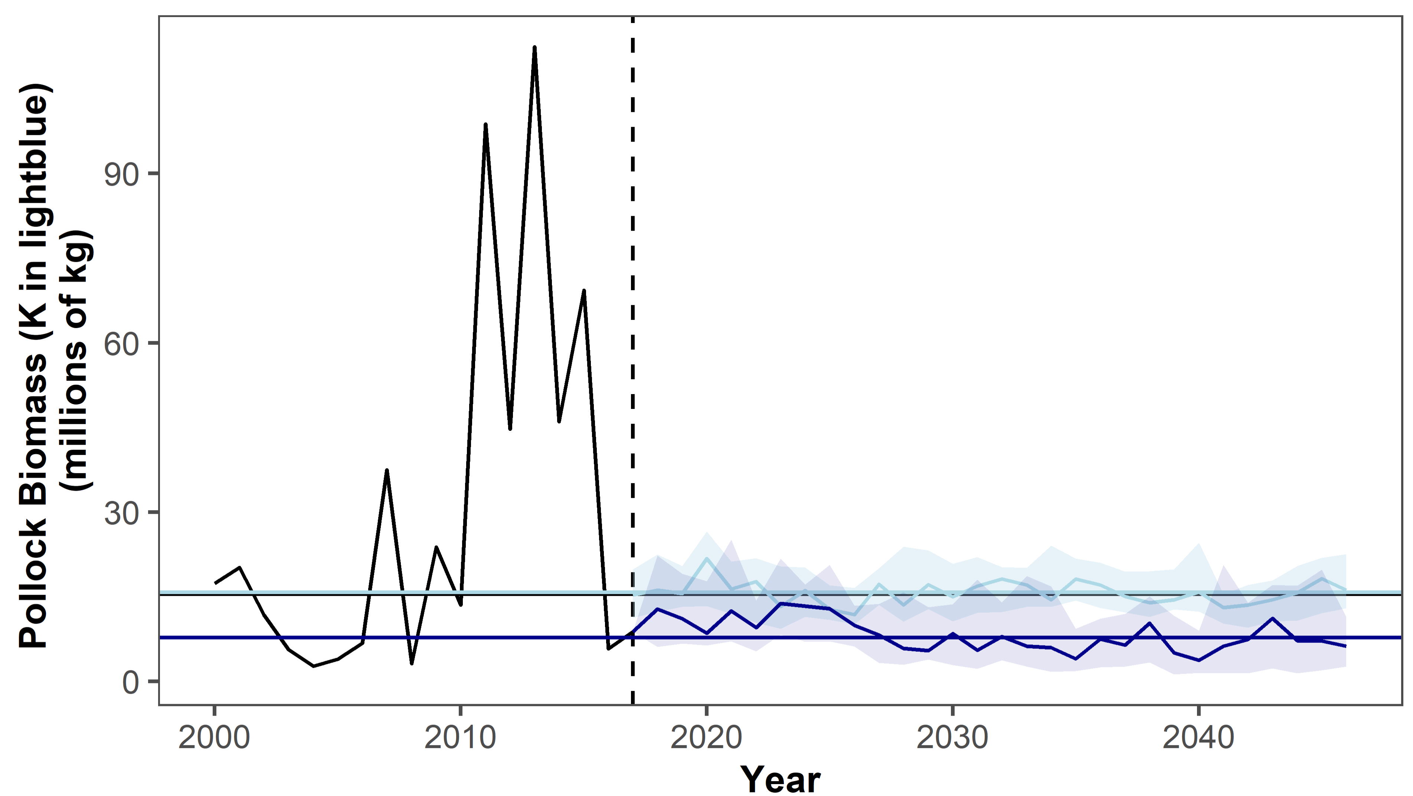

Slide 14
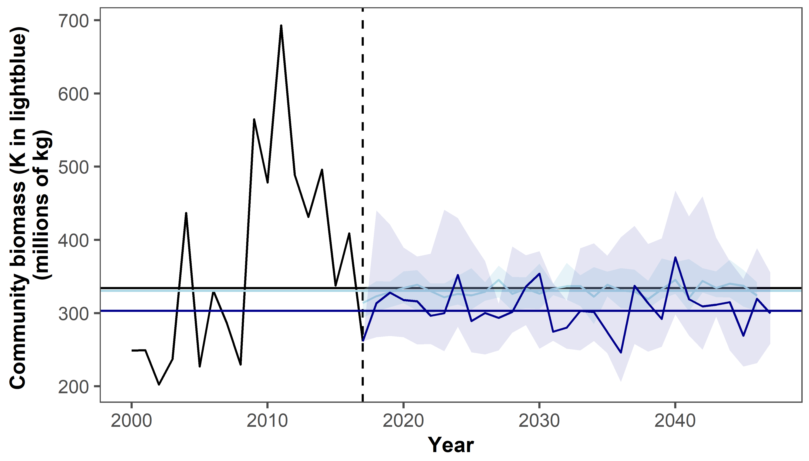
Notes:
TD is better, but still a bit low

Slide 15
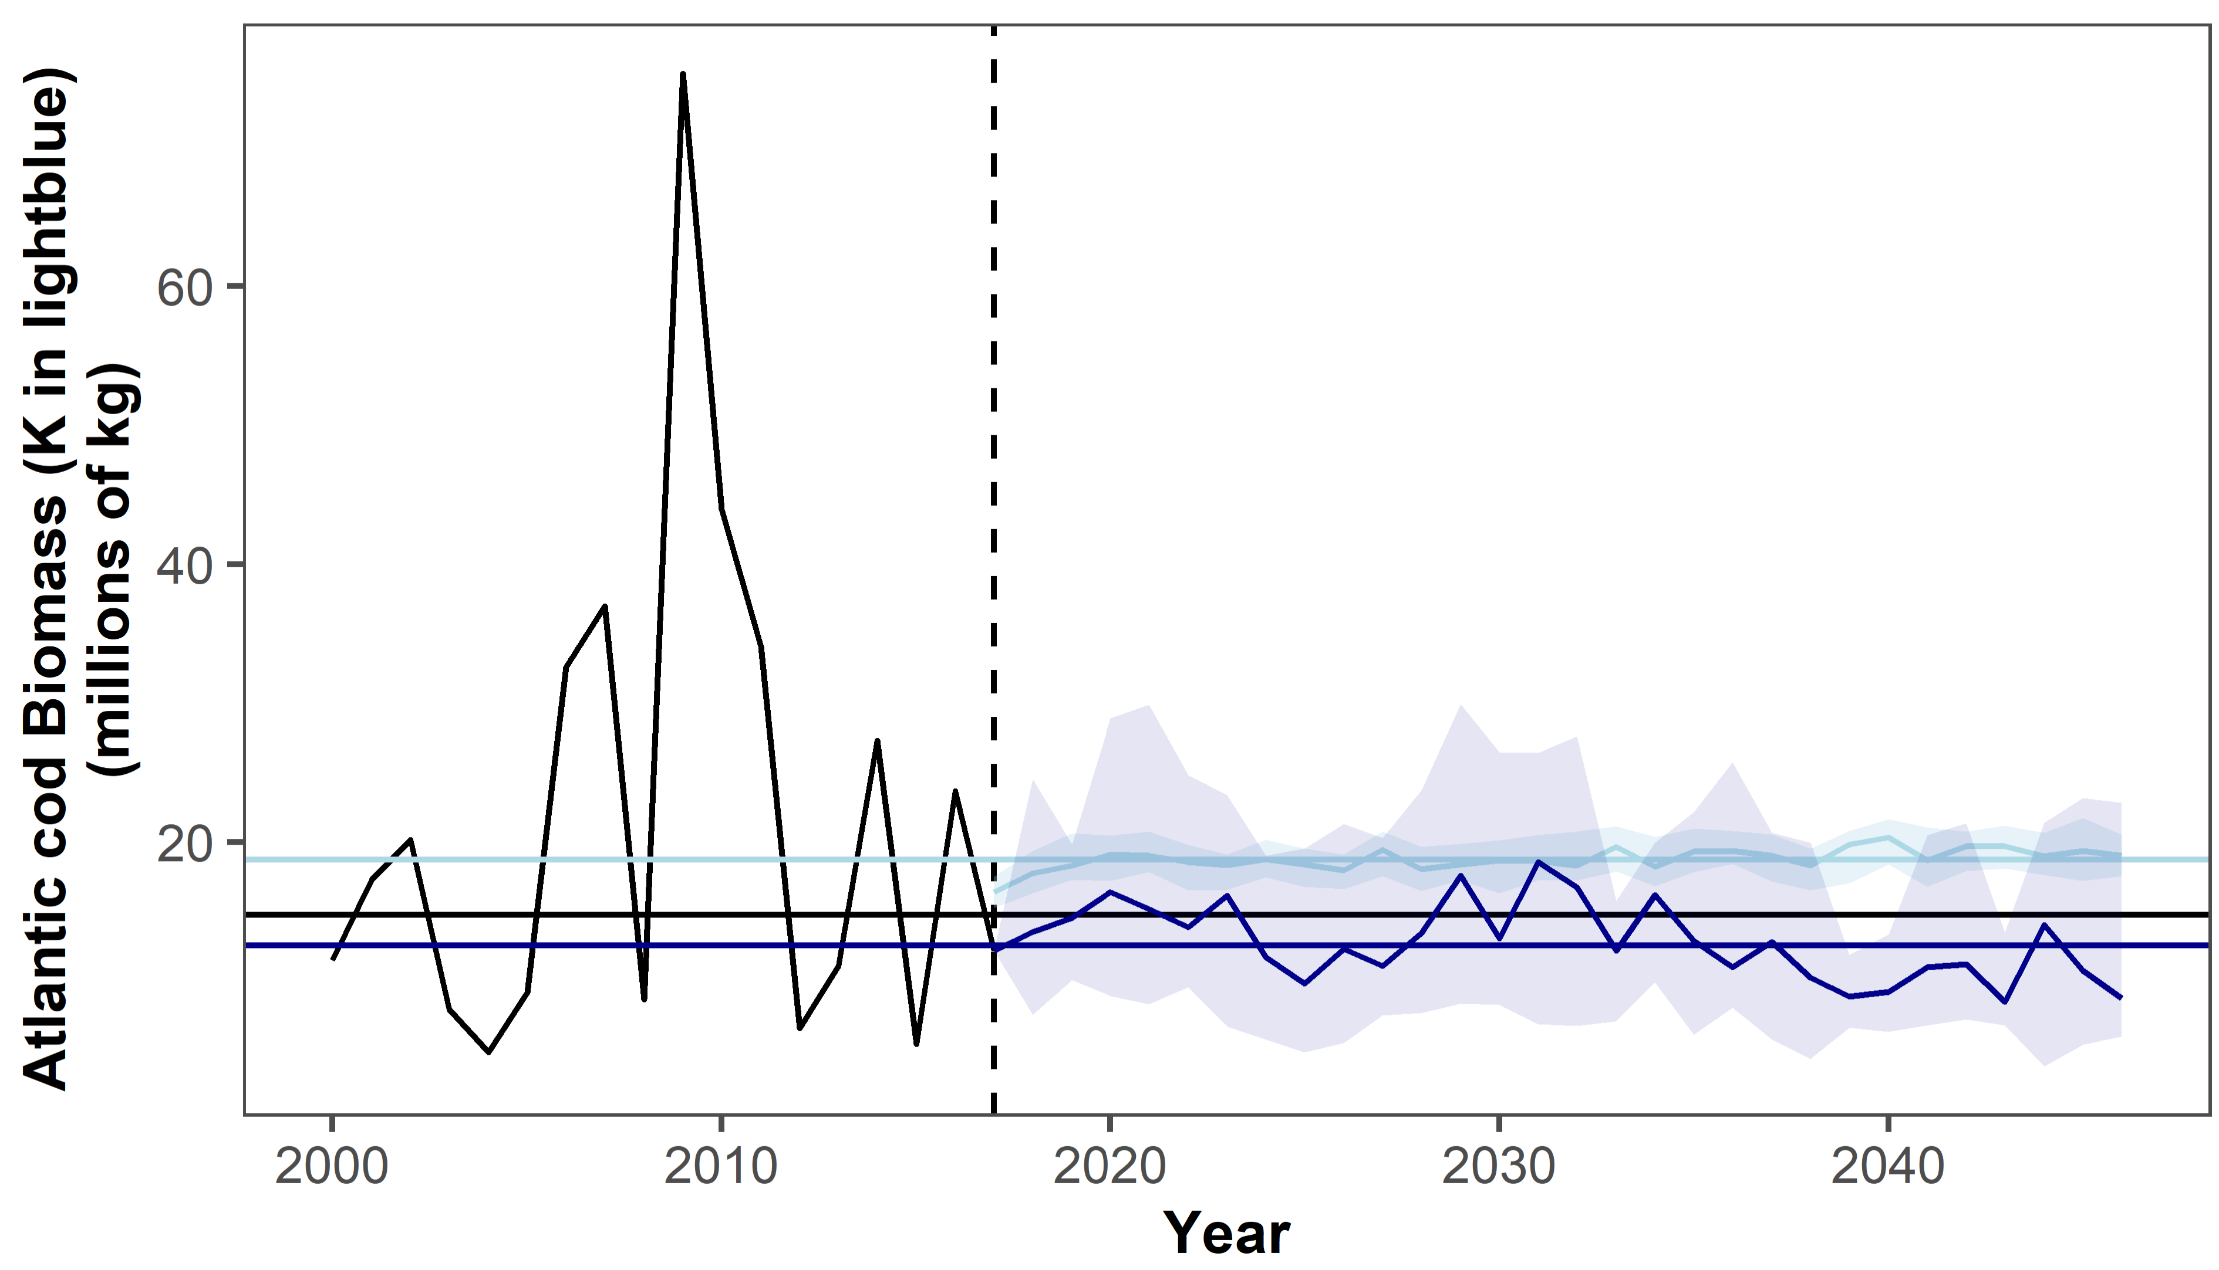

Slide 16
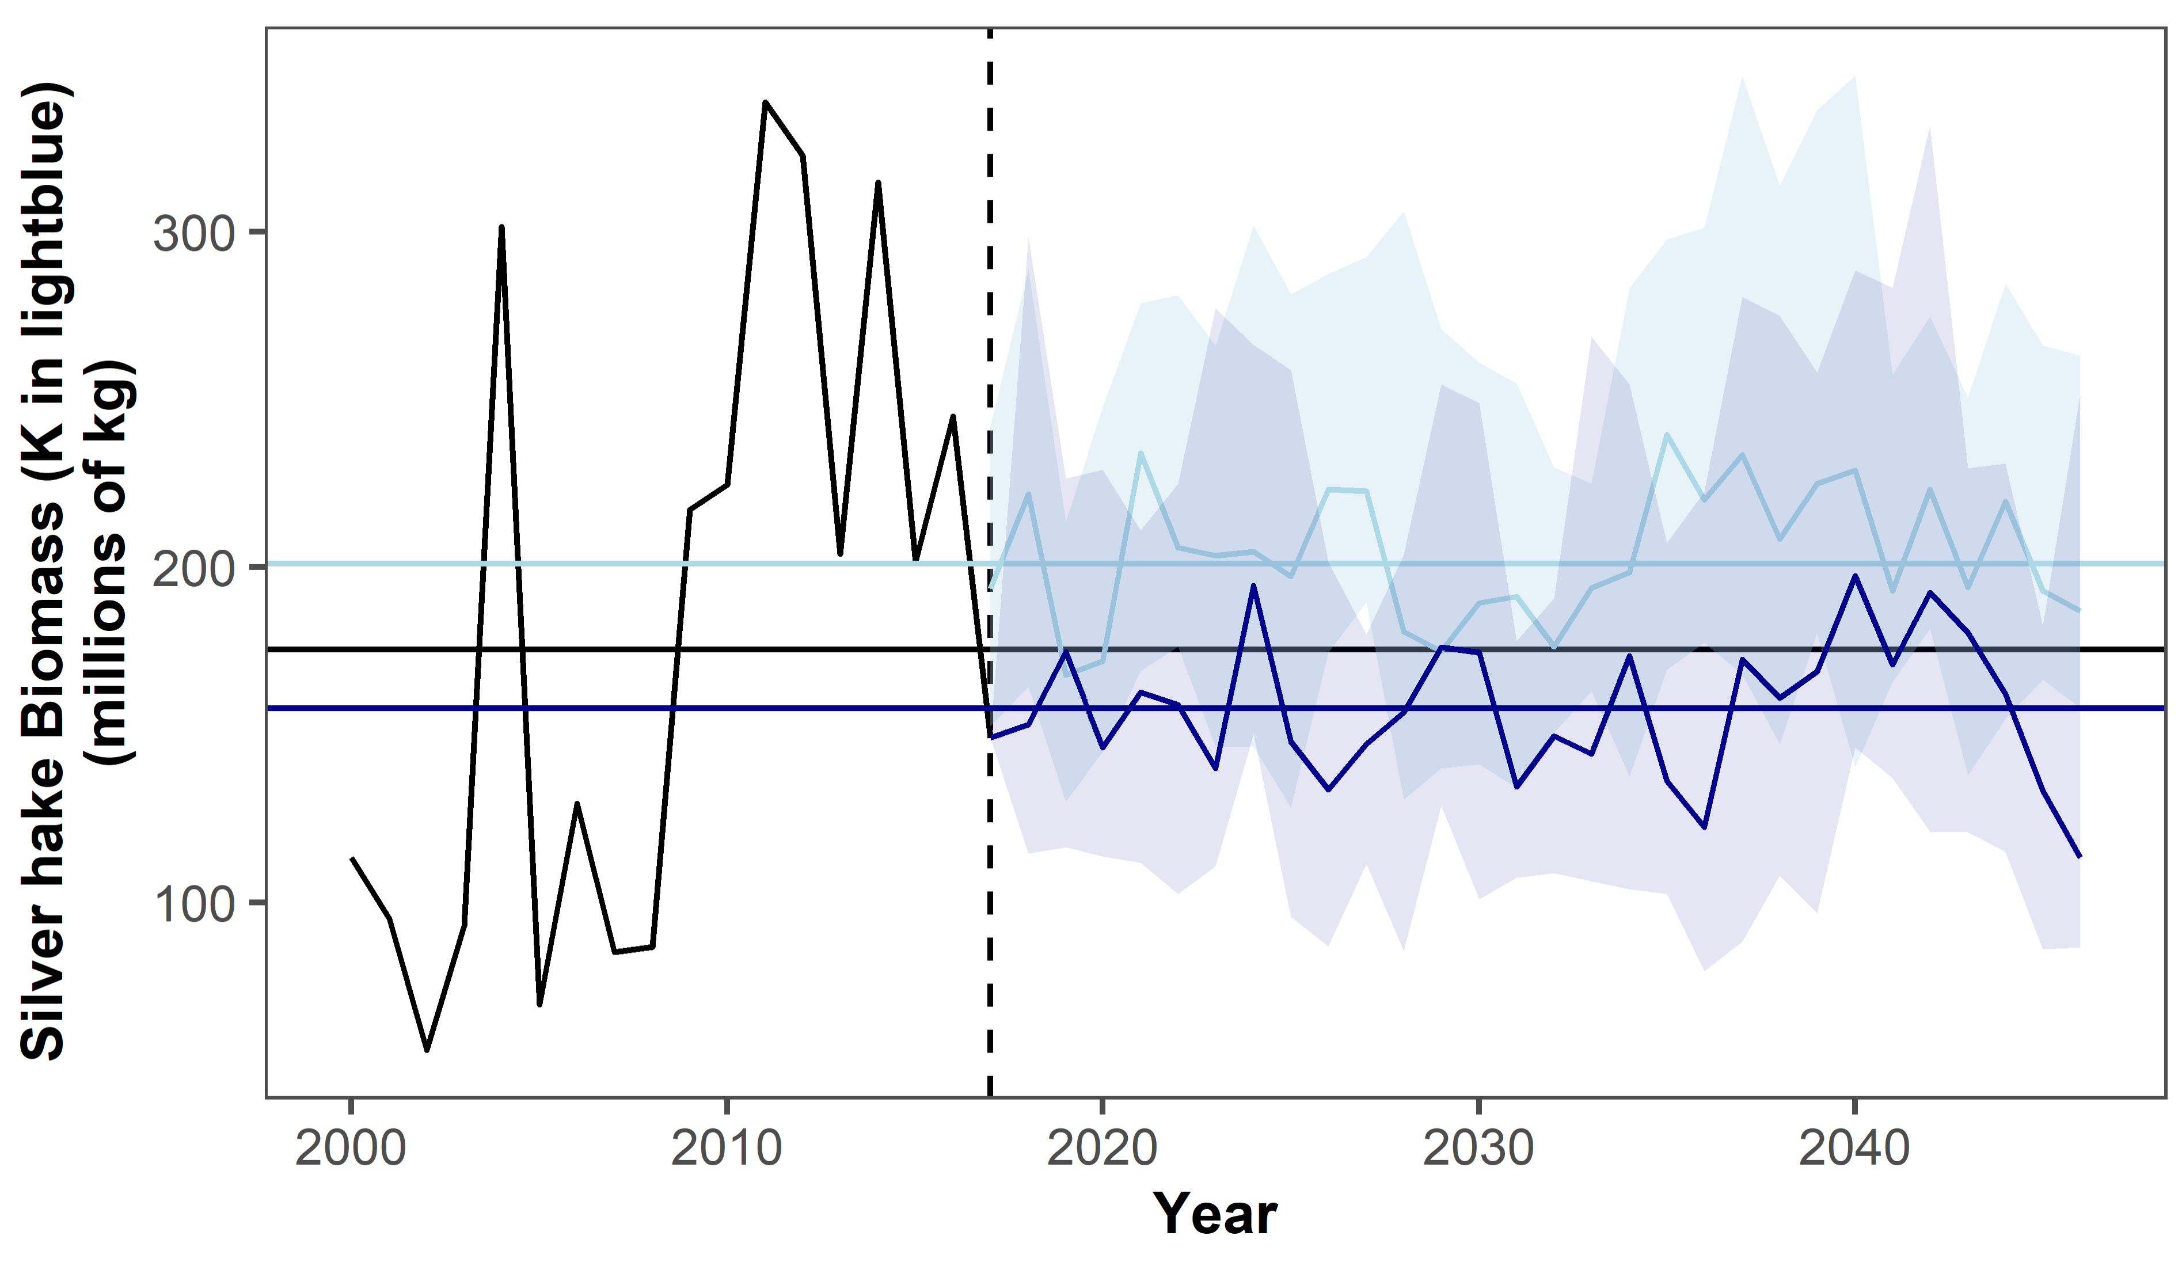

Slide 17
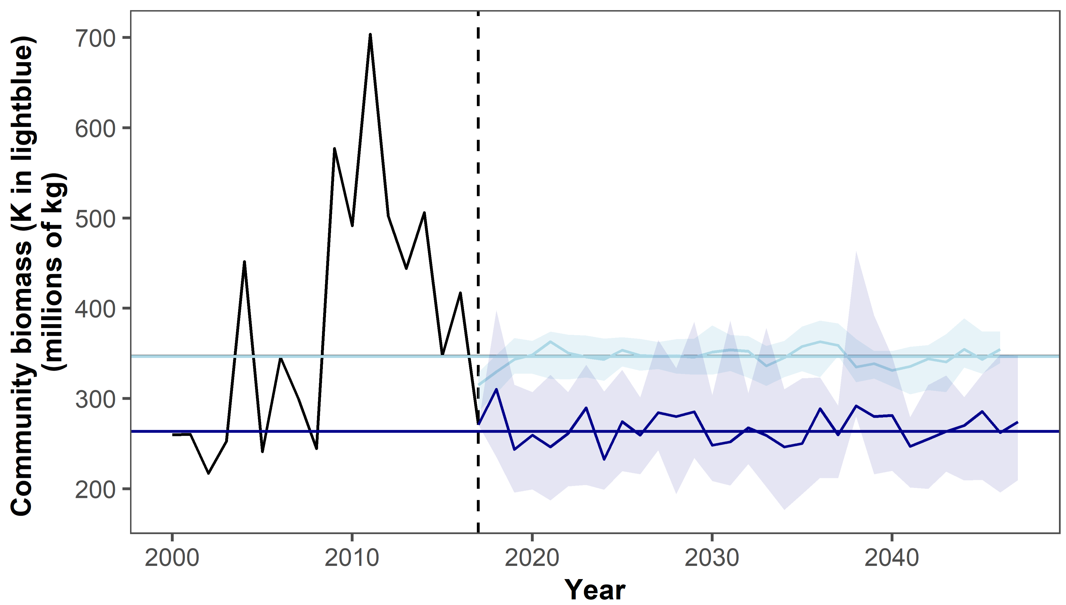

Slide 18
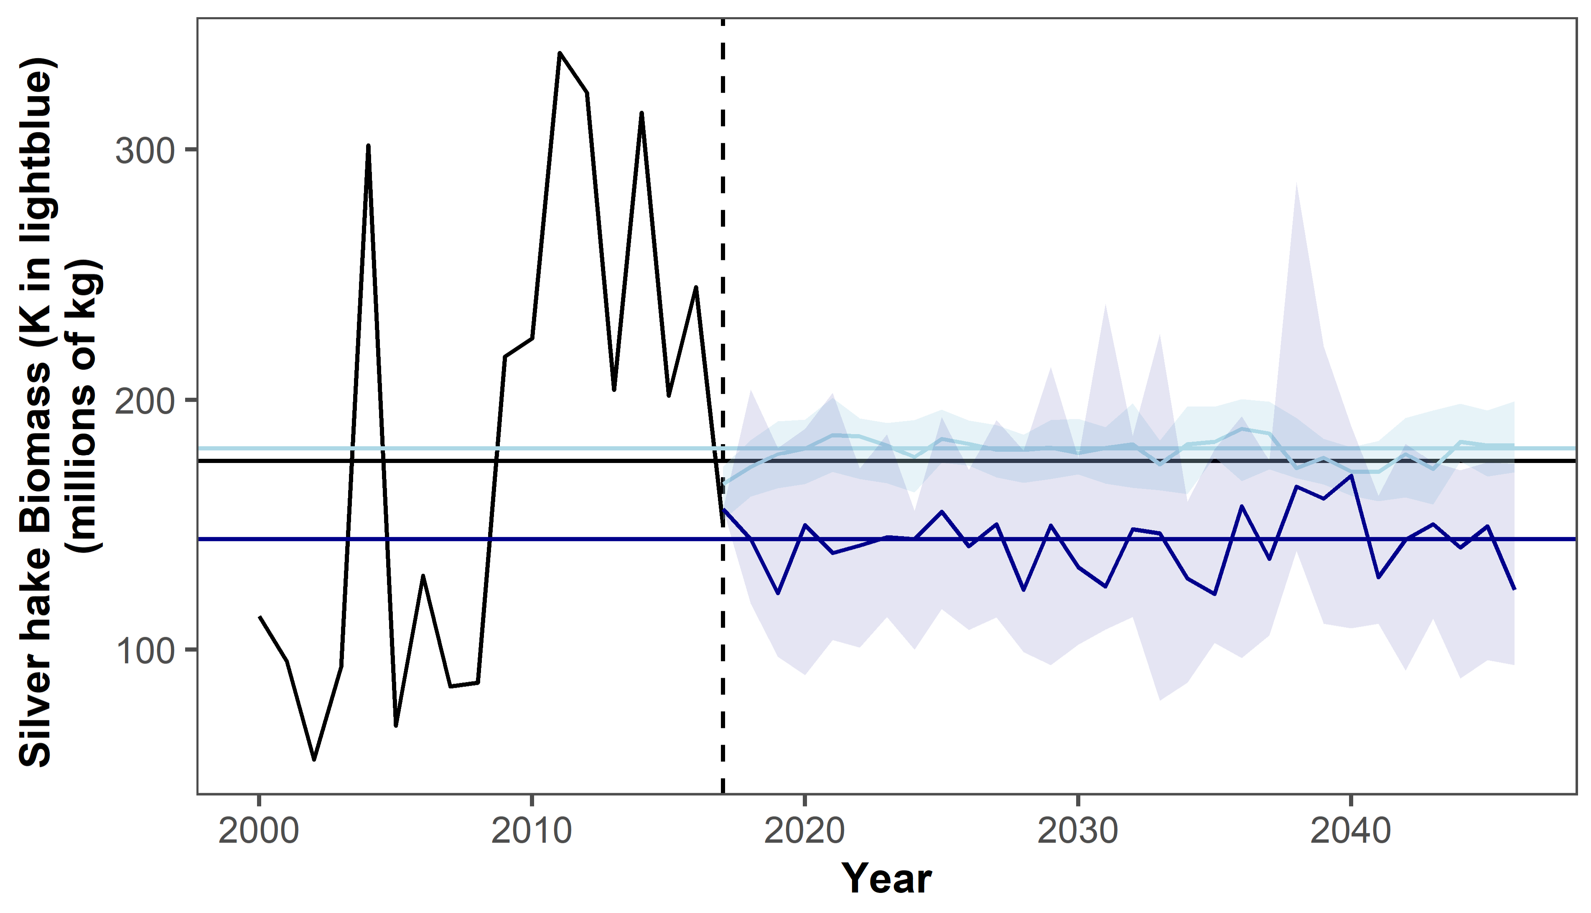
Notes:
K increased compared to original TS; biomass is a bit higher but still consistently below

Slide 19
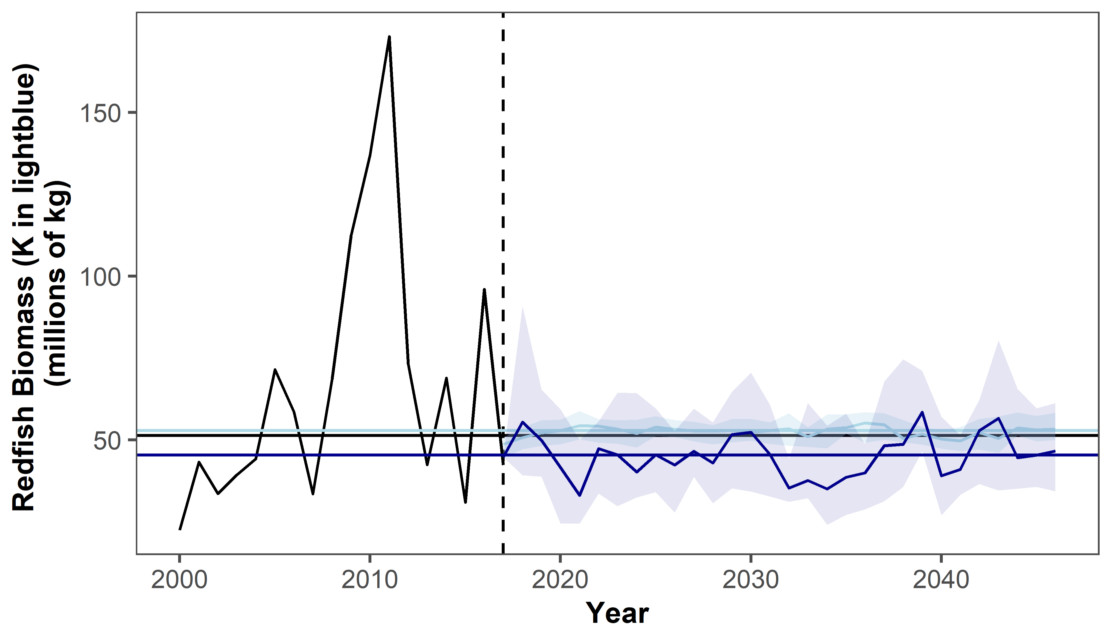
Notes:
More of a positive effect on redfish than seen in silver hake

Slide 20
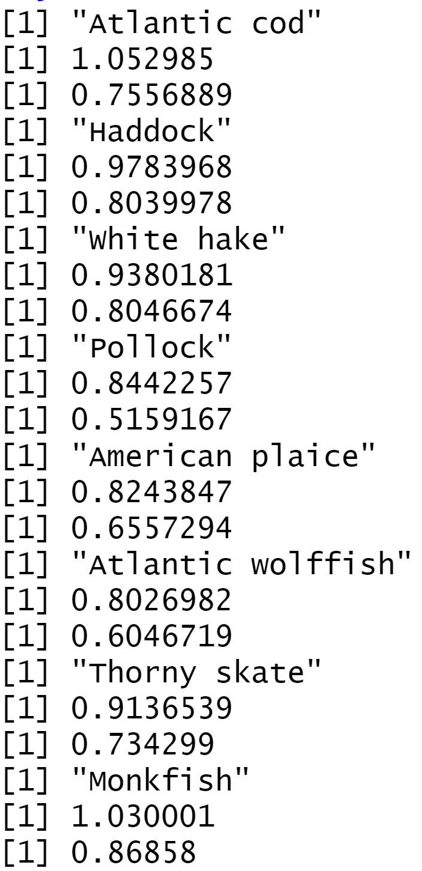
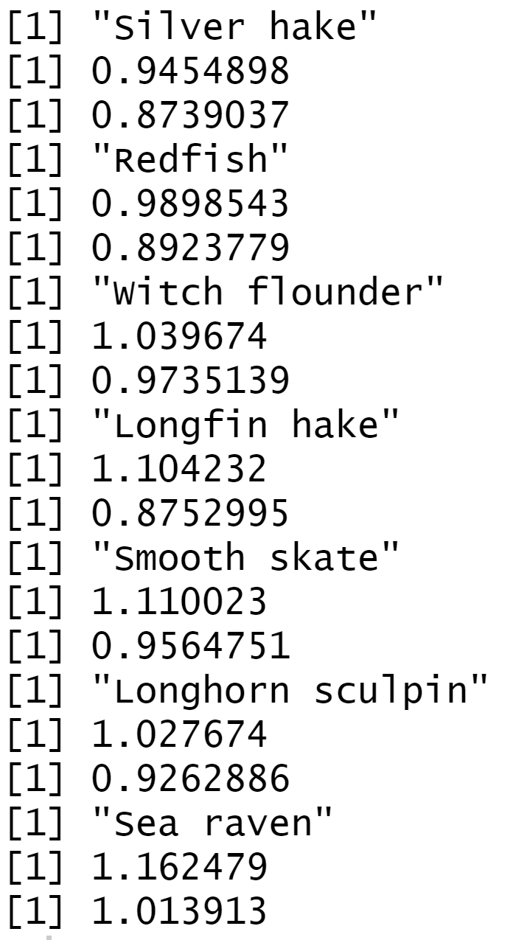
Notes:
BU mean and median ratio bm:K

Slide 21
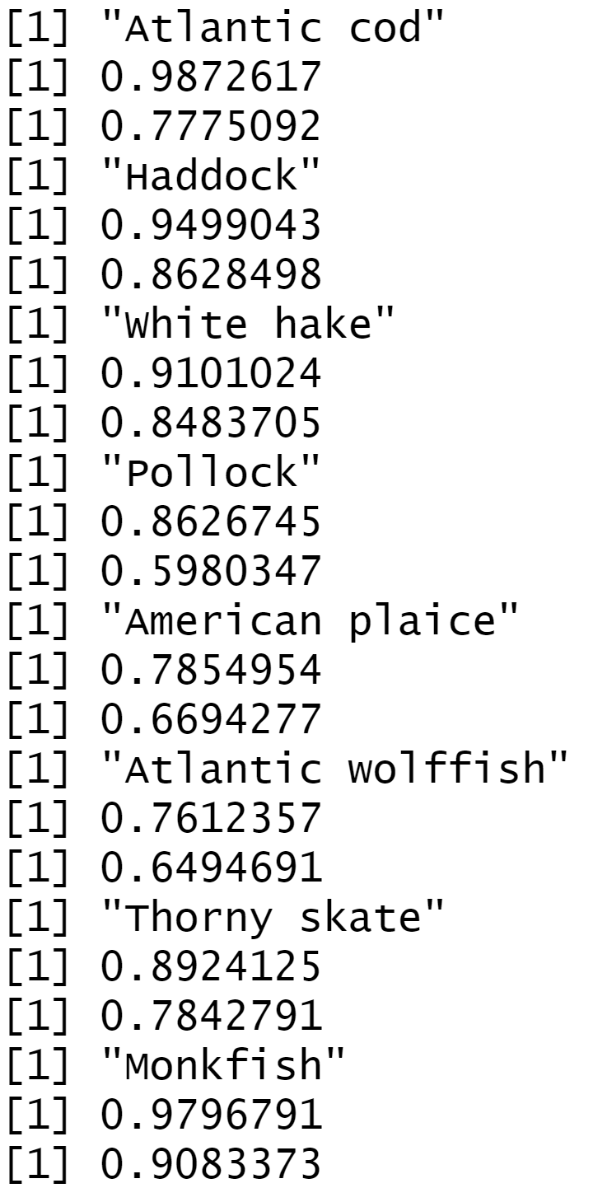
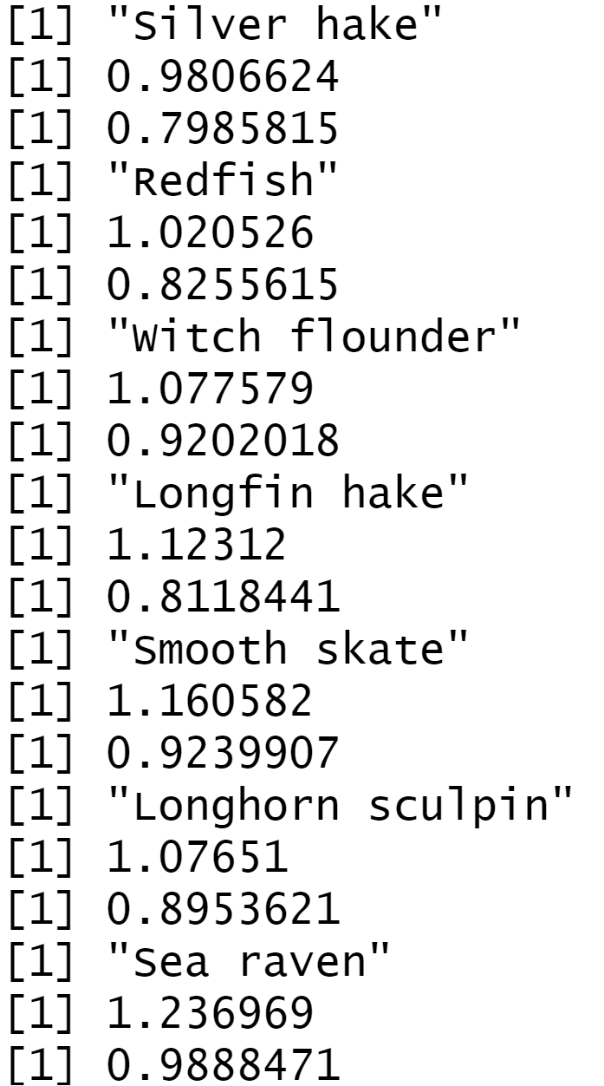
Notes:
TD mean and median ratio bm:K, 100

Slide 22
BU
TD

Slide 23
BU
TD

Slide 24
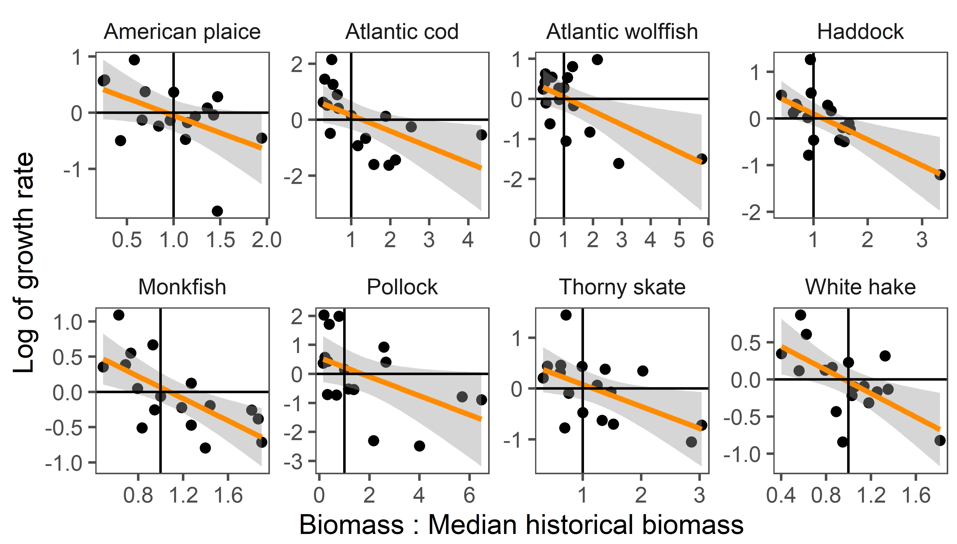

Slide 25
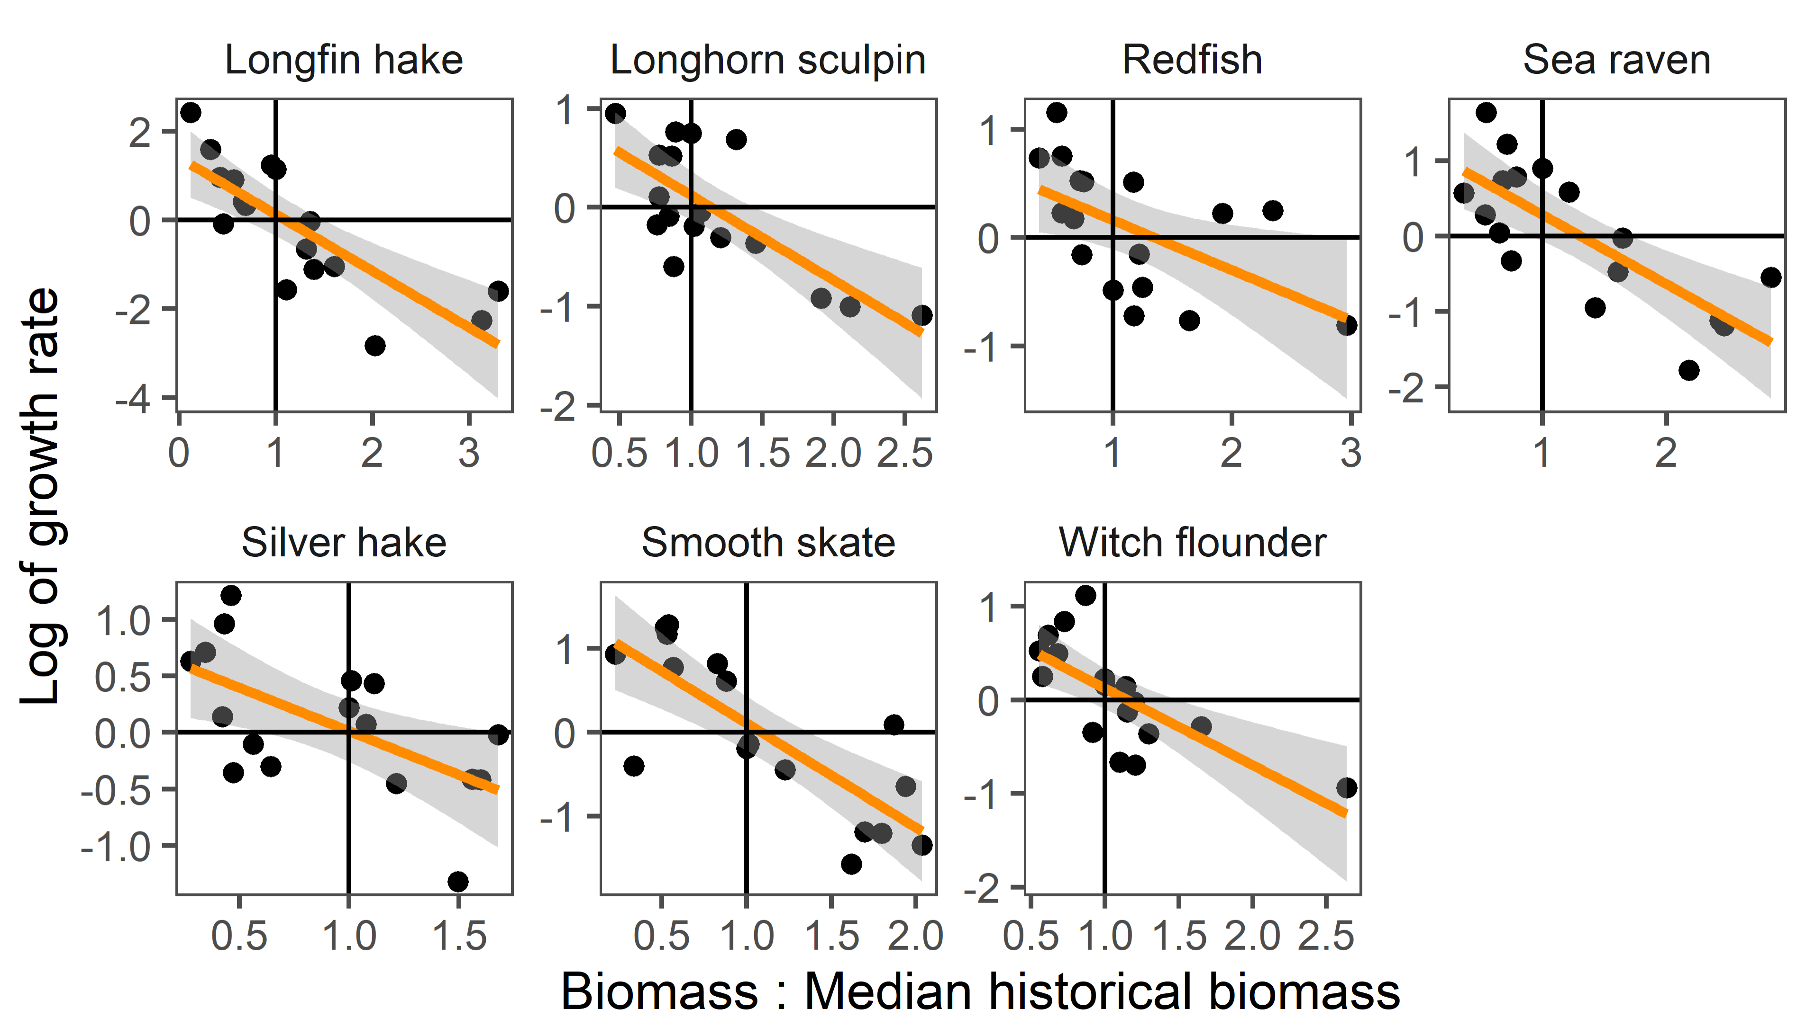

Slide 26
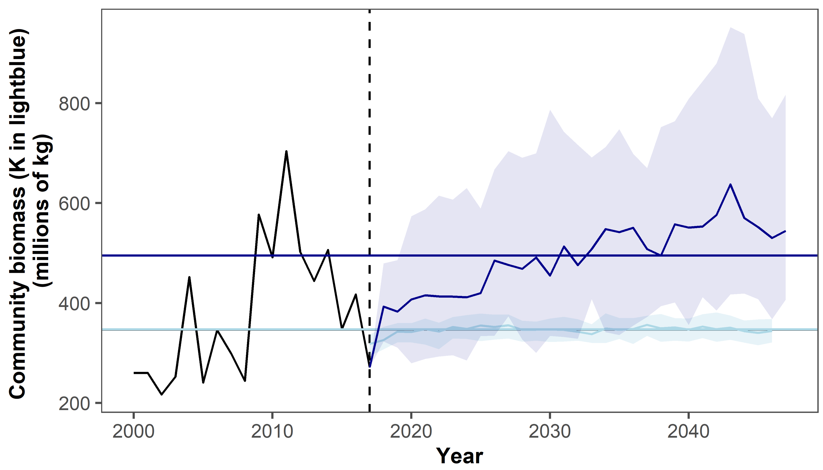
Notes:
BU no fish, 100 sims

Slide 27
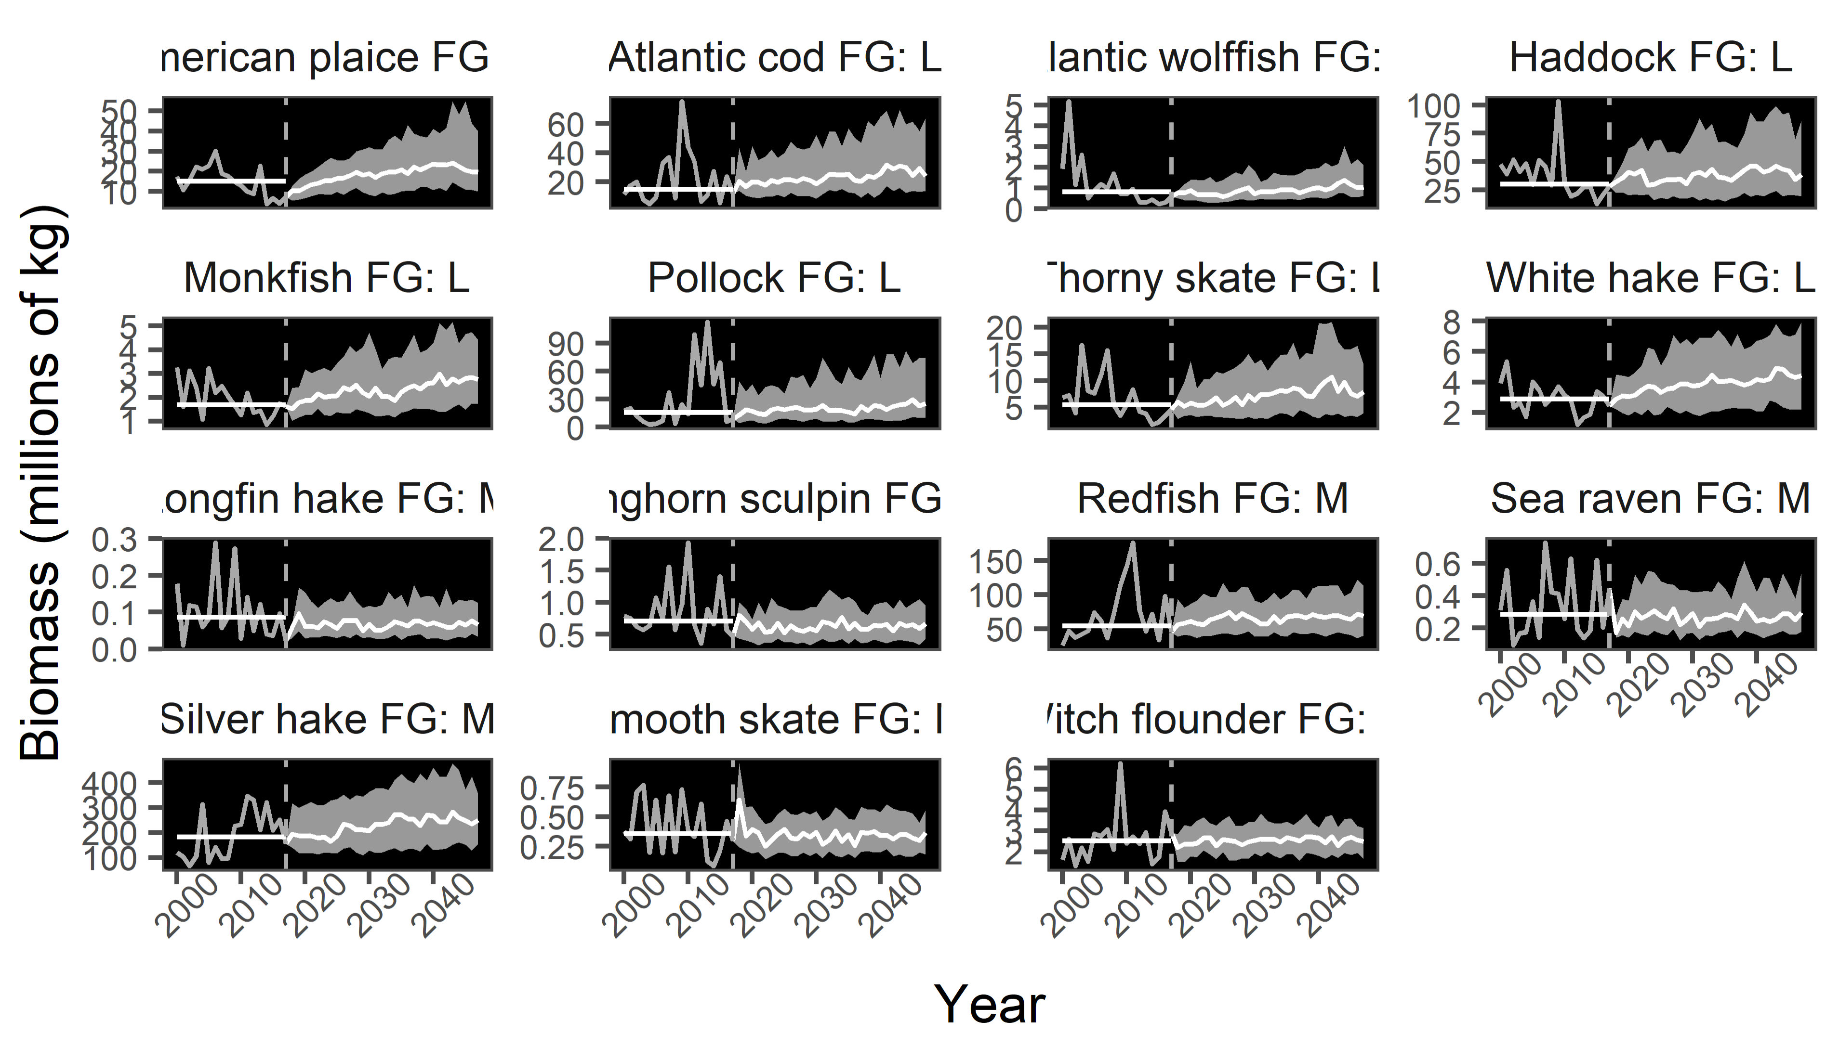
Notes:
BU no fish, 100 sims

Slide 28
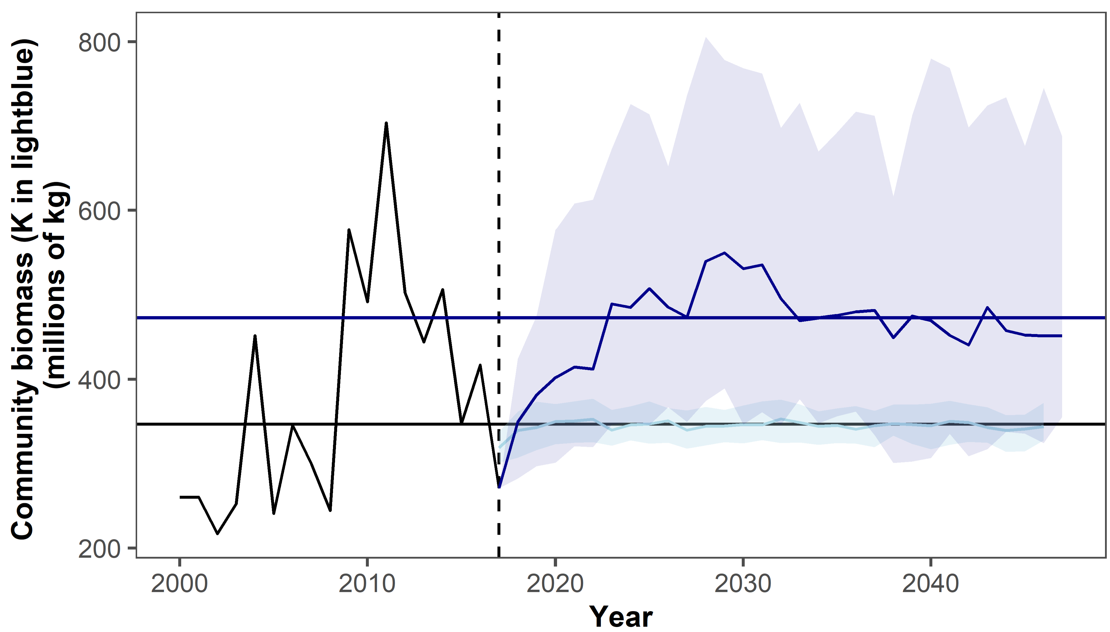
Notes:
TD no fish, 100 sims

Slide 29
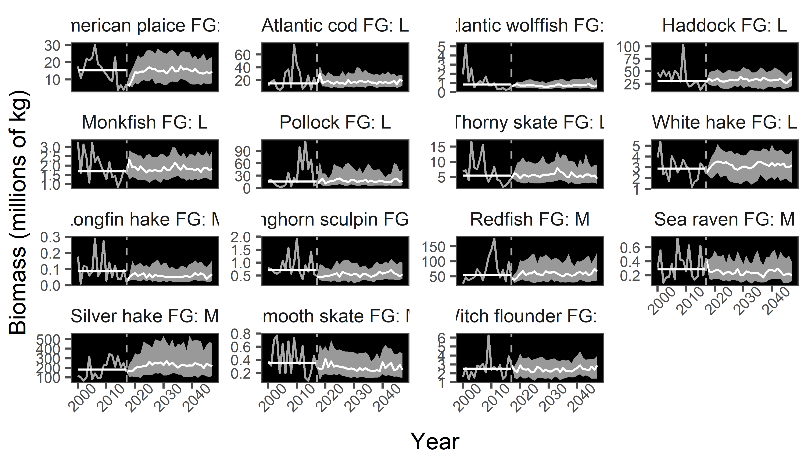
Notes:
TD no fish, 100 sims

